Slide 1
Weather & Data
Lesson 1: Understanding Microclimates

Slide 2
Learning Intentions
I am learning to define a climate and microclimate.

Slide 3
Climate
Can anyone guess what the term climate means?
The climate refers to the weather in one area . For example, in Scotland the climate is normally cold and wet.
Can you think of an example of a climate in another country?

Slide 4
Match the Climates
Match the pictures to their descriptions.

Slide 5
Match the Climates
Match the pictures to their descriptions.

Slide 6
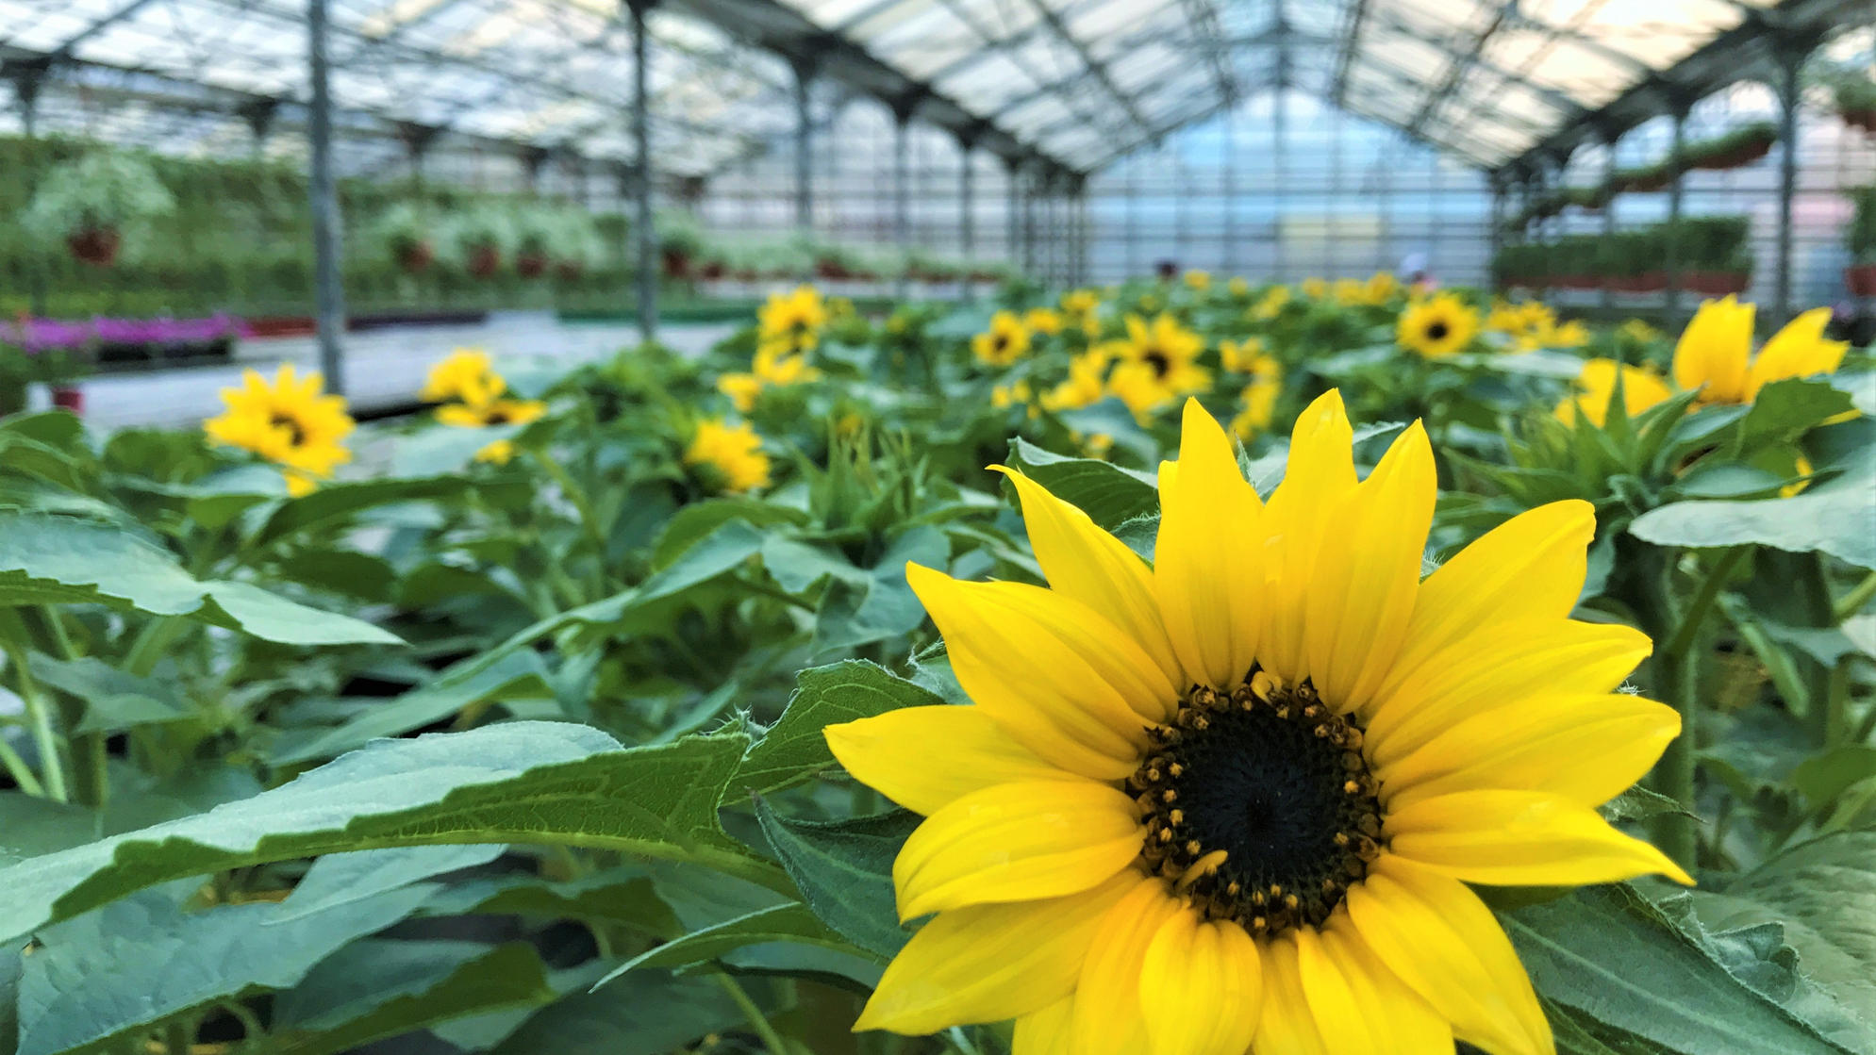
Microclimate
Can anyone guess what the term microclimate means?
A microclimate is a climate of a small space which is different from the climate around it.
Your classroom is a microclimate which is different from the climate outside.
Can you think of another example of a microclimate?

Slide 7
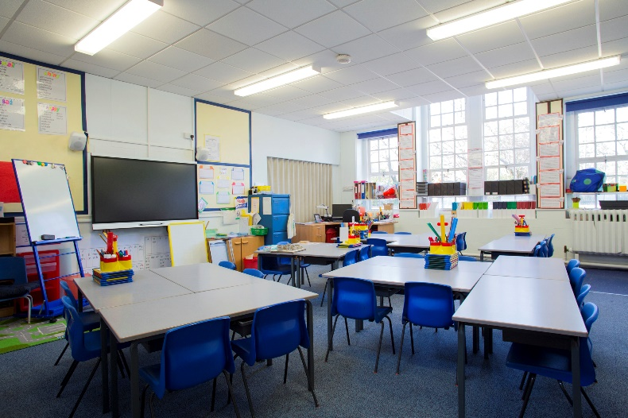
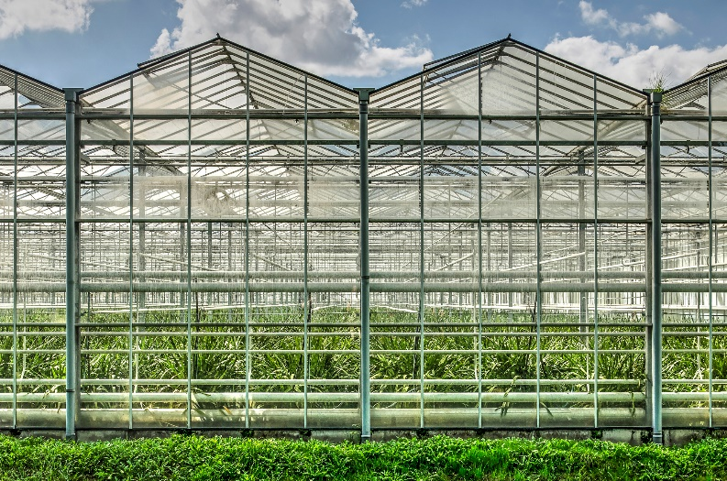
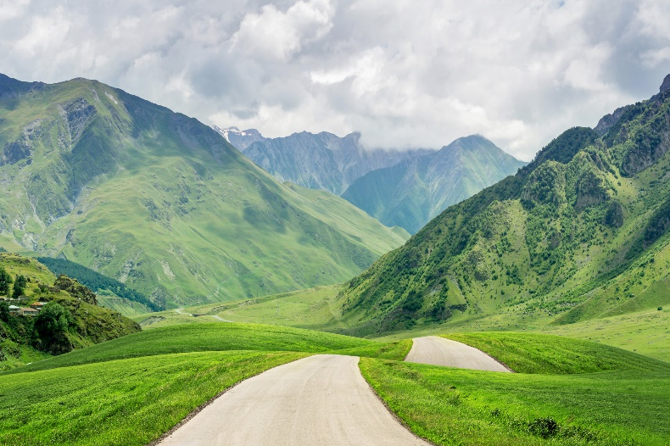
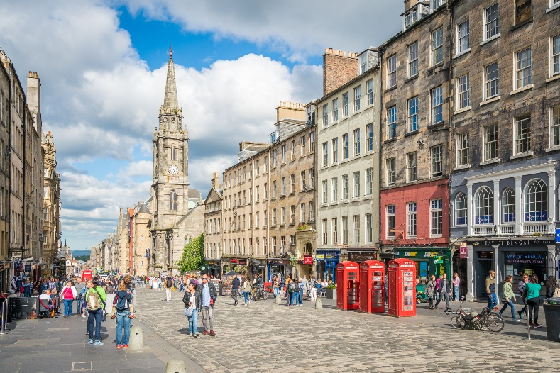
Microclimate or not?
With your partner sort these into whether they are a microclimate or not.

Slide 8
Design your own microclimate
You are going to design your own microclimate and explain what makes it a microclimate.
First lets discuss what makes places a microclimate.

Slide 9
End Discussion
Lets see some examples of your microclimates!

