Slide 1
Weather & Data
Lesson 2: What is a Variable?

Slide 2
Learning Intentions
I am learning what a variable is and how to identify variables.
I am learning to identify microclimates.

Slide 3
Does the classroom have a climate?
First let’s remind ourselves what we talked about last time.
What is a climate?
What is a microclimate?
Do you think the classroom is a microclimate? Things to think about: is the climate different inside the class than it is outside? What makes it different?

Slide 4
Variables
A variable is a word used in science to describe something which can be changed.
There are 2 main types of variables: independent and dependent.
Independent: This variable can be changed.
Dependent: The variable that is being tested in an experiment.
Experiments are scientific tests to find things out.

Slide 5
Independent and Dependent Variables
Independent Variable (What is changed) | Amount of Water | Amount of fertiliser
Value of the independent variable | little lot | little lot
Dependent Variable | Height of Plant | Height of plant
Effect

Slide 6
Match the Definitions: Task One
You are going to describe a term or a definition, you then need to go find someone who has the matching term or description.
For example: if you receive a card saying “variable” you would go find someone with a card saying “something which can be changed”
Once you have found a partner and checked you are a match sit down with them on the carpet and put your cards together.
Let’s see who will be the first to find a partner!

Slide 7
Check your answers
Variable
Dependent
Variable
Independent
Variable
Something which can be changed.
The variable being tested.
A variable which can be changed.
Microclimate
Experiment
Climate
The climate of a small space which differs from the climate outside it.
A scientific test.
The weather in an area.
A scientific test.
Experiment

Slide 8
Find the Variables: Task Two
With the partner you found in task one you are going to identify variables in your classroom.
Think about anything in the classroom that may influence the temperature in the classroom.
Be imaginative, picturing something in the class not being there and think if that would change anything.

Slide 9
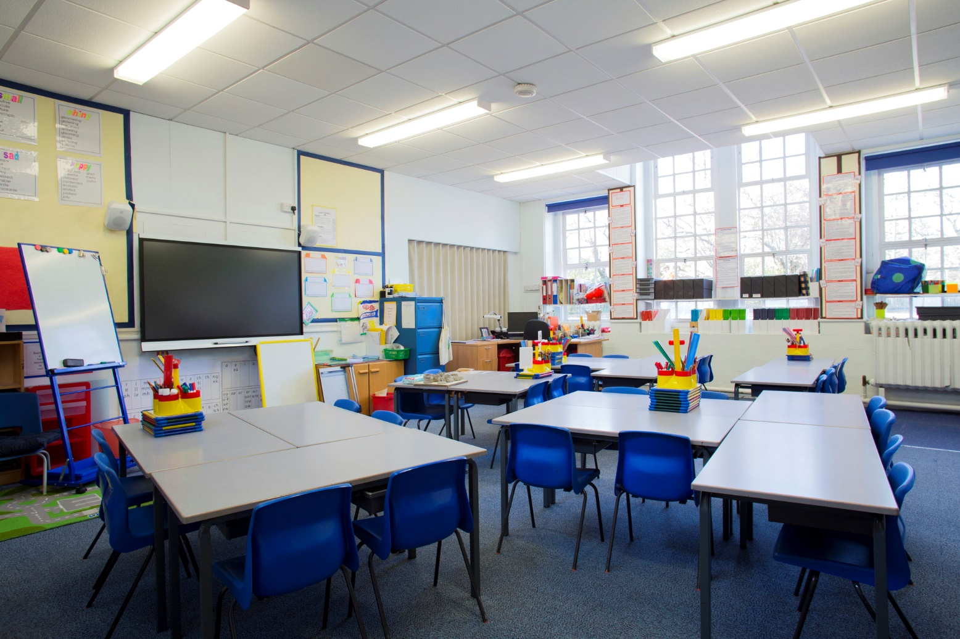
Share your findings
What did you find with your partner? Let’s share our answers!

Slide 10
Let’s think about we learned
We had 2 learning intentions today:-
I am learning what a variable is and how to identify variables.
I am learning to identify microclimates.
Use a fist to five to show me how well you understand what you learned.

