Slide 1
Settling In
Some data oriented settling in tasks 1st & 2nd Level

Slide 2
A Data Riddle
I am a delicious way of showing data, what am I?

Slide 3
Number Puzzle
You have to place all the numbers from 1 to 9 in the table.
All numbers must only be in the table once.
The numbers must add up to 15 in each row, column and on the diagonal.
You can work in pairs

Slide 4
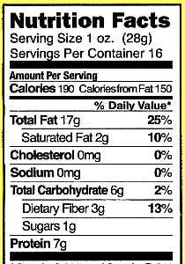
Find the data errors
Jack and Maria went shopping.
They were checking the nutrition information on the food they were buying.
They spotted errors in the labels. Can you find the errors?
LABEL 1
Some tips for finding the errors:
Find the weight of each serving of food.
Look at the values for item, does it make sense given what you know about the total weight of the food? For example is 16g 25% of the total weight of a serving?
Work through each item and decide if it is accurate.
LABEL 2

Slide 5
Solve the animal riddle
Animal | Length
Blue Whale | 25 metres
Humpback Whale | 16 metres
Manatee | 4 metres
Orca | 5 metres
Harbor Seal | 2 metres
Sea Otter | 1 metre
Use this table of data on marine mamals to solve the riddle.
This marine mammal’s length is an odd number.
This marine mammal is longer than a manatee
This marine mammal is 5 times longer than an orca
What marine mammal is it?

Slide 6
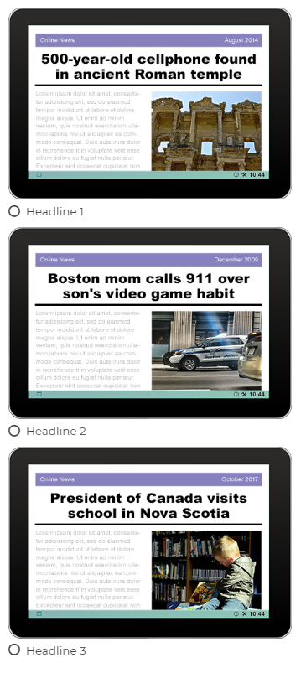
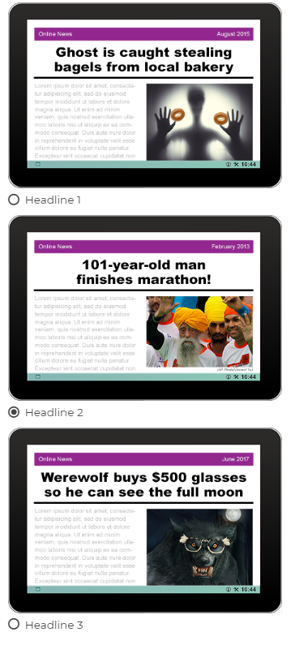
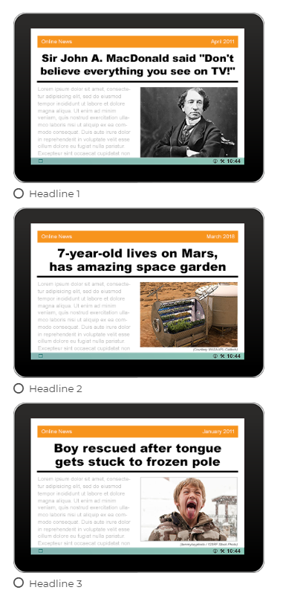
Data Detectives
Can you be a data detective and decide which of the headlines are true?
Think about what information you used to make your decision. How do you decide if it is fact or fake?

Slide 7
Sort Your Class Lego Bricks
Do you have LEGO in your class?
Is it tidy?
Can you find the pieces you want?
Lets sort it!
Take a pile of Lego from the box
How could you sort it?
How about:
Size
Colour
brick type
What do you think is the best way to sort Lego and why?
Image by gradmom11 from Pixabay

